Slide 1
The great Escape
By: Abel Kuriakose, Yohan, Avi, Isaiah and Brian

Slide 2
The Layout of the project
Divide problem into components​
Draft data definitions for the different components and the server​
Design a communication protocol​
Update data definitions where needed​
Design marshaling and unmarshaling functions​
Create data definitions for to-server and for to-world messages​
Implement the components (starting with handlers)​
Implement the server (starting with handlers)​
Test your program​

Slide 3
The Setting up the multiplayer Client
Constants
(define MY-ID "Yohan") ; make sure your ID is unique
This is the first part of the code
This defines the ID of the player, for multiplayer, so that the computer can distinguish who is playing as who
(define WIDTH 800)
(define HEIGHT 500)
(define EMPTY-SCENE (empty-scene WIDTH HEIGHT))
(define ROCKET-DELTA-X 10)
(define ROCKET-IMG .)
(define ROCKET-IMG2 .)
(define ALIEN-INIT-Y 50)
(define ALIEN-DELTA-X 2)
(define ALIEN-DELTA-Y 10)
(define ALIEN-IMG .)

Slide 4
; DATA DEFINITIONS
; A rocket is a positive number, r, such that 0<=r<=WIDTH-1.
; Example
(define ROCKET (/ WIDTH 2))
; ; The distributed setting introduces more rockets to the game. Therefore, we
; ; need the following definitions:
; An ally rocket, (make-ar x y n), is a structure where x is a number, y is a number and n is a string.
(define-struct ar (x y name))
; A list of ally rockets, loar, is either:
; 1. empty
; 2. (cons r l), where r is an ar and l is a list of ar.
Examples:
(define INIT-LOAR empty)
(define INIT-LOAR1 (list (cons (make-ar 23 54 "avi") (cons (make-ar 34 45 "yo") empty))))
Rocket data
Definitions

Slide 5
; An alien is a posn
; Example
(define ALIEN (make-posn (/ WIDTH 2) ALIEN-INIT-Y))
; TEMPLATE FOR FUNCTIONS ON ALIENS
; ;Contract:
; ;f-on-alien: alien --> ???
; ;Purpose:
; (define (f-on-alien an-alien)
; ;INVENTORY
; ;an-alien is a posn
; ;(posn-x an-alien) is the x coordinate of an-alien
; ;(posn-y an-alien) is the y coordinate of an-alien
; ...)
; A list-of-aliens (loa) is either:
; 1. empty
; 2. (cons a l), where a is an alien and l is a loa
;EXAMPLES
(define LOA1 empty)
(define LOA2 (cons ALIEN LOA1))
(define INIT-LOA (list (make-posn (- (/ WIDTH 2) 350) ALIEN-INIT-Y)
(make-posn (- (/ WIDTH 2) 175) ALIEN-INIT-Y)
(make-posn (/ WIDTH 2) ALIEN-INIT-Y)
(make-posn (+ (/ WIDTH 2) 175) ALIEN-INIT-Y)
(make-posn (- (/ WIDTH 2) 300) (+ ALIEN-INIT-Y 90))
(make-posn (- (/ WIDTH 2) 150) (+ ALIEN-INIT-Y 90))
(make-posn (/ WIDTH 2) (+ ALIEN-INIT-Y 90))
(make-posn (+ (/ WIDTH 2) 150) (+ ALIEN-INIT-Y 90))
(make-posn (- (/ WIDTH 2) 350) (+ ALIEN-INIT-Y 160))
(make-posn (- (/ WIDTH 2) 175) (+ ALIEN-INIT-Y 160))
(make-posn (/ WIDTH 2) (+ ALIEN-INIT-Y 160))
(make-posn (+ (/ WIDTH 2) 175) (+ ALIEN-INIT-Y 160))
))
Data Definition
for Aliens

Slide 6
; DATA DEFINITION
(define-struct world (allies aliens dir over))
; A world is a structure, (make-world l a d s o), where
; l is a list of ar, a is a aoa, d is a direction "left"
; or "right" (representing the direction the alien travels),
; s is a los, and o is a boolean.
; EXAMPLE
(define INIT-WORLD (make-world INIT-LOAR
INIT-LOA
"left"
false))
; ; f-on-world: world --> ???
; ; Purpose:
; (define (f-on-world a-world)
; ; INVENTORY
; ; (world-rocket a-world) this is the rocket in a-world
; ; (world-aliens a-world) this is the aoa in a-world
; ; (f-on-loa (world-aliens a-world)) the ??? for the loa in a-world
; ; (world-dir a-world) this is the direction in a-world
; ; (world-shots a-world) this is the shot in a-world
; ; (f-on-los (world-shots a-world)) the ??? for the los in a-world
; ...
; )
; A univ is a structure, (make-univ l w), where l is a (listof iworld) and w is a world
(define-struct univ (worlds state))
(define initU (make-univ empty INIT-WORLD))
World
definitions

Slide 7
; MOVING FUNCTIONS
; ;TEMPLATE
; ; move-rocket: rocket string --> rocket
; ; Purpose: ???
; (define (move-rocket ... direction)
; ;INVENTORY
; ;(key=? direction "right") checks whether given direction is right or not
; ;(key=? direction "left") checks whether given direction is left or not
; (cond [(... (key=? direction "right")
; (...(+ a-rocket ROCKET-DELTA-X) (- WIDTH 40)))
; (... a-rocket ROCKET-DELTA-X)]
; [(... (key=? direction "left")
; (... (... a-rocket ROCKET-DELTA-X) 40))
; (... a-rocket ROCKET-DELTA-X)]
; [else ....]))
; move-rocket: rocket string --> rocket
; Purpose: To move the rocket in the given direction
(define (move-rocket a-rocket direction)
;INVENTORY
(cond [(and (key=? direction "right")
(<= (+ a-rocket ROCKET-DELTA-X) (- WIDTH 40)))
(+ a-rocket ROCKET-DELTA-X)]
[(and (key=? direction "left")
(>= (- a-rocket ROCKET-DELTA-X) 40))
(- a-rocket ROCKET-DELTA-X)]
[else a-rocket]))
(check-expect (move-rocket ROCKET "right") (+ ROCKET ROCKET-DELTA-X))
(check-expect (move-rocket ROCKET "left") (- ROCKET ROCKET-DELTA-X))
(check-expect (move-rocket ROCKET "prior") ROCKET)
;(check-expect (move-rocket 10 "right") (+ 10 ROCKET-DELTA-X))
;(check-expect (move-rocket 10 "left") (- 10 ROCKET-DELTA-X))
Moving
functions

Slide 8
Universe functions
Moving-ally function
Moving function
; move-ally: loar name string --> loar
(define (move-ally l nm dir)
(cond [(empty? l) (error "empty ally list!")]
[(string=? nm (ar-name (first l)))
(cond [(string=? dir "right")
(cons (make-ar (+ (ar-x (first l)) ROCKET-DELTA-X)
(ar-y (first l))
(ar-name (first l)))
(rest l))]
[(string=? dir "left")
(cons (make-ar (- (ar-x (first l)) ROCKET-DELTA-X)
(ar-y (first l))
(ar-name (first l)))
(rest l))]
[else (cons (first l) (move-ally (rest l) nm dir))])]
[else (cons (first l) (move-ally (rest l) nm dir))]))
; MOVING FUNCTIONS
; move-rocket: rocket string --> rocket
; Purpose: To move the rocket in the given direction
(define (move-rocket a-rocket direction)
(cond [(and (string=? direction "end") ; or right
(<= (+ a-rocket ROCKET-DELTA-X) WIDTH))
(+ a-rocket ROCKET-DELTA-X)]
[(and (string=? direction "home") ; or left
(>= (- a-rocket ROCKET-DELTA-X) 0))
(- a-rocket ROCKET-DELTA-X)]
[else a-rocket]))

Slide 9
Moving Ally
Function
; move-ally: loar name string --> loar
;Purpose: to move allied rocket in the directions
(define (move-ally l nm dir)
;INVENTORY
(cond [(empty? l) (error "empty ally list!")]
[(string=? nm (ar-name (first l)))
(cond [(string=? dir "right")
(cons (make-ar (+ (ar-x (first l)) ROCKET-DELTA-X)
(ar-y (first l))
(ar-name (first l)))
(rest l))]
[(string=? dir "left")
(cons (make-ar (- (ar-x (first l)) ROCKET-DELTA-X)
(ar-y (first l))
(ar-name (first l)))
(rest l))]
[else (cons (first l) (move-ally (rest l) nm dir))])]
[else (cons (first l) (move-ally (rest l) nm dir))]))

Slide 10
; move-alien: alien string --> alien
;Purpose: To move the given alien in the given direction by ALIEN-DELTA-X
; making sure the alien does not go off the scene
(define (move-alien an-alien direction)
; INVENTORY
; an-alien is a posn
; (posn-x an-alien) is the x coordinate of an-alien
; (posn-y an-alien) is the y coordinate of an-alien
(cond [(and (string=? direction "right")
(< (+ (posn-x an-alien) ALIEN-DELTA-X) WIDTH))
(make-posn (+ (posn-x an-alien) ALIEN-DELTA-X) (posn-y an-alien))]
[(and (string=? direction "left")
(>= (- (posn-x an-alien) ALIEN-DELTA-X) 0))
(make-posn (- (posn-x an-alien) ALIEN-DELTA-X) (posn-y an-alien))]
[else an-alien]))
; move-loa: loa string --> loa
; PURPOSE: To move the given loa in the given direction
(define (move-loa a-loa direction)
(cond [(empty? a-loa) a-loa]
[else (cons (move-alien (first a-loa) direction) (move-loa (rest a-loa) direction))]))
;move-ally-up
(define (move-ally-up an-ally)
(cond [(not (ally-reached-top? an-ally)) (make-ar (ar-x an-ally) (- (ar-y an-ally) 5) (ar-name an-ally))]
[else (make-ar (ar-x an-ally) 10 (ar-name an-ally))]))
(define (move-allies-up a-loar)
(cond [(empty? a-loar) a-loar]
[else (cons (move-ally-up (first a-loar)) (move-allies-up (rest a-loar)))]))
Moving a
List of Aliens

Slide 11
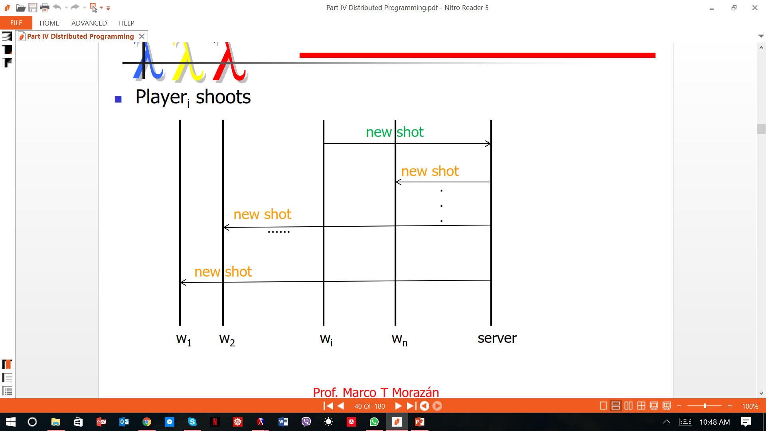
Hit the alien
;alien-hit?
(define (alien-hit? an-alien an-ally)
(cond [(and (<= (abs (- (ar-x an-ally) (posn-x an-alien)))
ALIEN-WIDTH)
(<= (abs (- (ar-y an-ally) (posn-y an-alien)))
ALIEN-HEIGHT))true]
[else false]))
;ally-hit-any-alien?: a-loa an-ally-> boolean
(define (ally-hit-any-alien? a-loa an-ally)
(cond [(empty? a-loa) false]
[else (or (alien-hit? (first a-loa) an-ally) (ally-hit-any-alien? (rest a-loa) an-ally))]))

Slide 12
;reset-allies: a-loar an-alien --> a-loar
(define (reset-ally a-loar a-loa)
(cond [(empty? a-loar) empty]
[else (cond [(ally-hit-any-alien? a-loa (first a-loar)) (cons (make-ar (ar-x (first a-loar)) HEIGHT (ar-name (first a-loar))) (reset-ally (rest a-loar) a-loa))]
[else (cons (first a-loar) (reset-ally (rest a-loar) a-loa))])]))
(define (ally-reached-top? an-ally)
(cond [(= (ar-y an-ally) 0) true]
[else false]))
Resetting allies

Slide 13
UPDATING THE WORLD
Templates for updating the world
; update-world: world --> world
; Purpose: To produce a new world at every tick
(define (update-world a-world)
; INVENTORY
; (world-rocket a-world) this is the rocket in a-world
; (world-alien a-world) this is the alien in a-world
; (world-dir a-world) this is the direction in a-world
; (posn-x (world-alien a-world)) the x of the alien in a-world
; (posn-y (world-alien a-world)) the y of the alien in a-world
(cond [... (...)]
[else ...]))

Slide 14
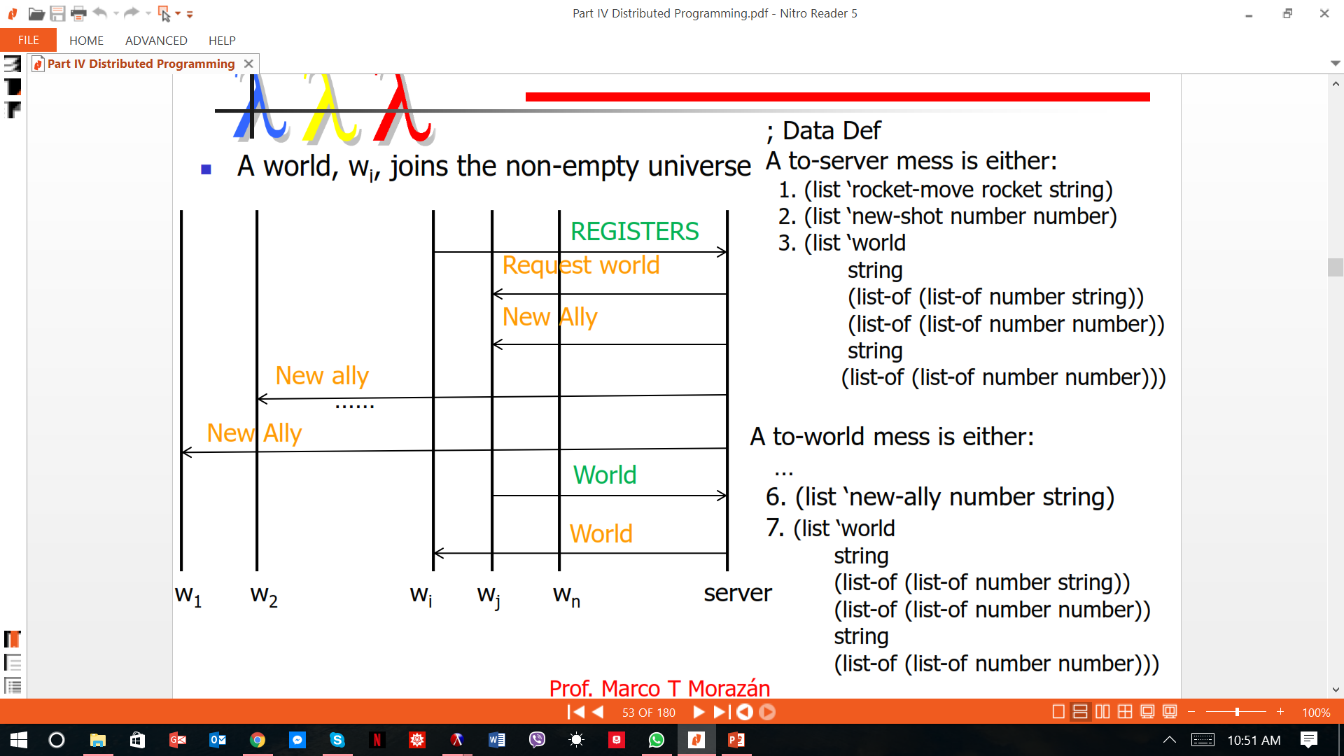
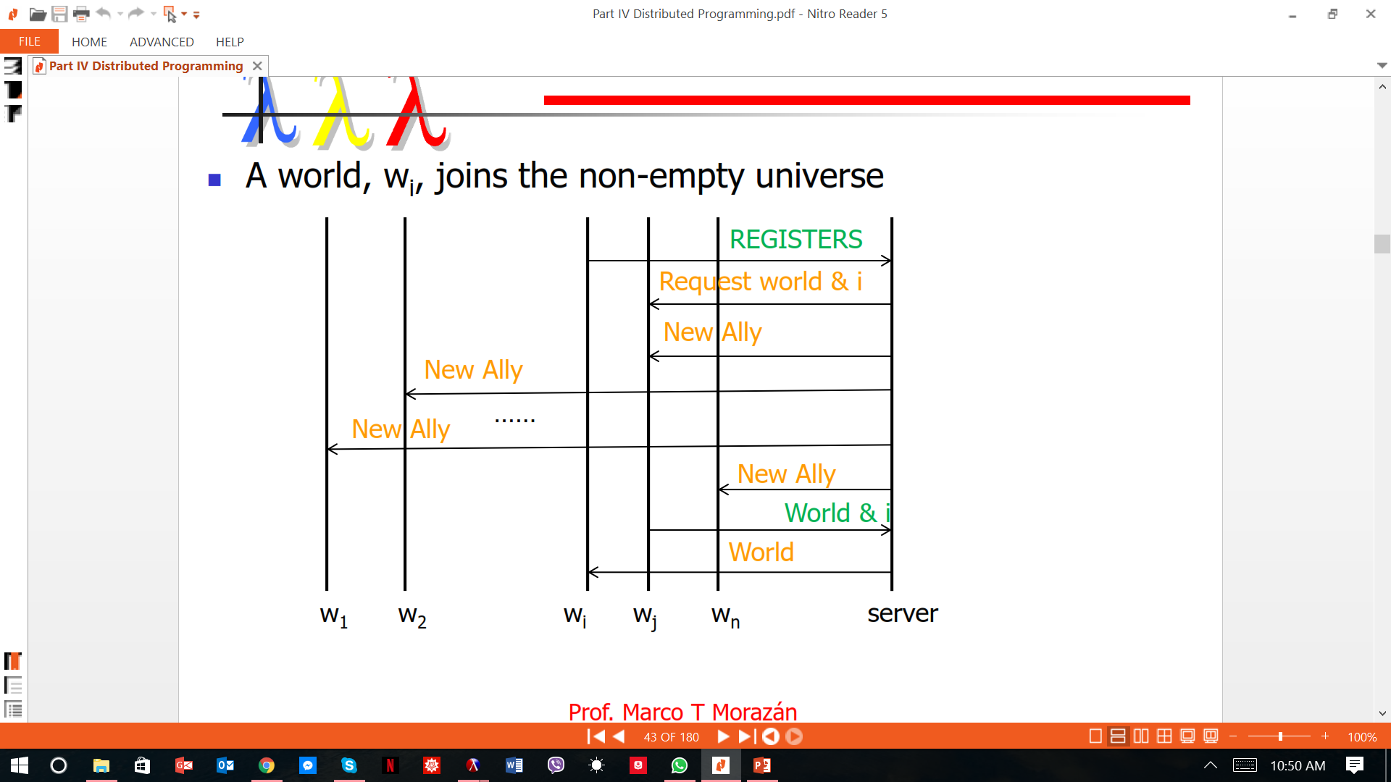
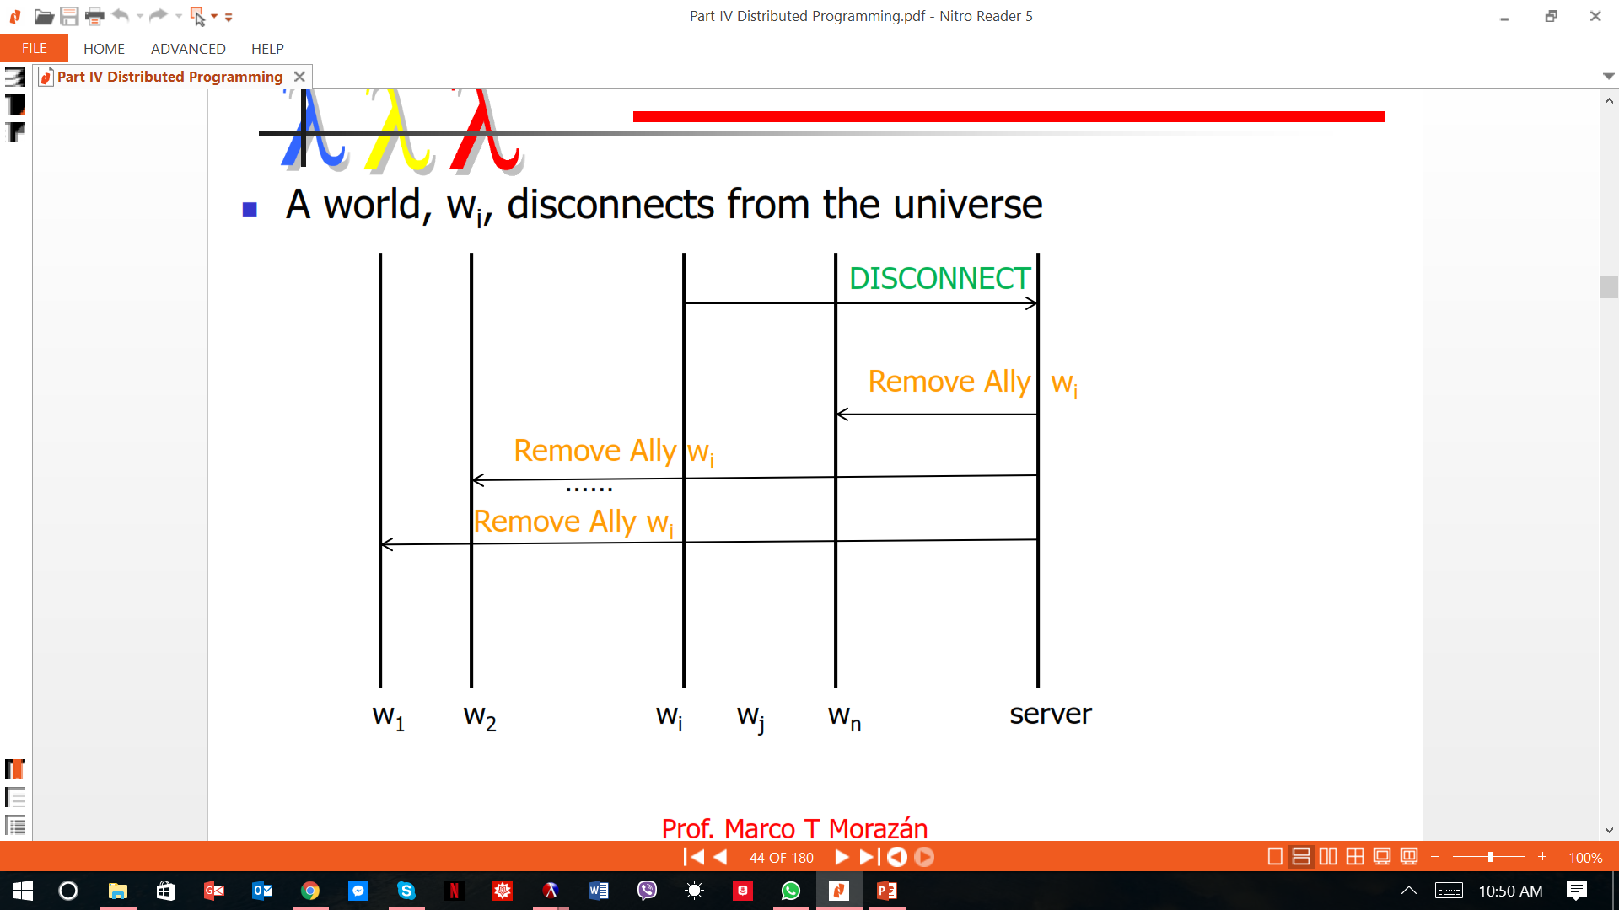
Communication
Protocol

Slide 15
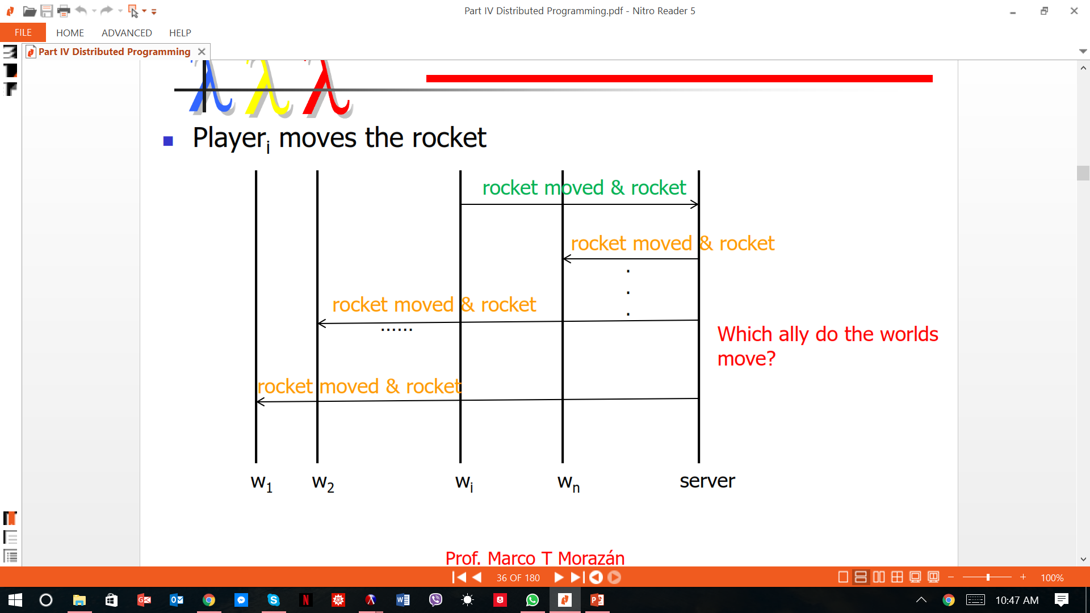
Communication
Protocol
(big-bang INIT-WORLD
(on-draw draw-world)
(on-key process-key)
(on-receive process-message)
(register LOCALHOST)
(name MY-ID)
(stop-when game-over?))
Player connects using Ip Address to universe from client
The Player connects to the game
Player 2 and others join
(universe initU
(on-new add-new-world)
(on-msg receive-message)
(on-disconnect rm-this-world)
(on-tick update-univ)
)
Players Disconnect
CS
C4
C3
C2
C1
Server

Slide 16
Updating
the
world
functions
(define (update-world a-world)
; INVENTORY
; (world-rocket a-world) this is the rocket in a-world
; (world-alien a-world) this is the alien in a-world
; (world-dir a-world) this is the direction in a-world
; (posn-x (world-alien a-world)) the x of the alien in a-world
; (posn-y (world-alien a-world)) the y of the alien in a-world
(cond [(is-any-alien-at-l-edge-loa? (world-aliens a-world))
(make-world (reset-ally (move-allies-up (world-allies a-world)) (world-aliens a-world))
(move-loa (world-aliens a-world) "right")
"right"
(world-over a-world))]
[(is-any-alien-at-r-edge-loa? (world-aliens a-world))
(make-world (reset-ally (move-allies-up (world-allies a-world)) (world-aliens a-world))
(move-loa (world-aliens a-world) "left")
"left"
(world-over a-world))]
[else (make-world (reset-ally (move-allies-up (world-allies a-world)) (world-aliens a-world))
(move-loa (world-aliens a-world) (world-dir a-world))
(world-dir a-world)
(world-over a-world))]))

Slide 17
;Contract:
; alien-at-r-edge?: alien --> boolean
;Purpose: To determine if the alien is on the right edge of the scene
(define (is-alien-at-r-edge? an-alien)
; INVENTORY
; an-alien is a posn
; (posn-x an-alien) is the x coordinate of an-alien
; (posn-y an-alien) is the y coordinate of an-alien
(>= (+ (posn-x an-alien) ALIEN-DELTA-X)
(sub1 WIDTH)))
; is-any-alien-at-r-edge?: loa --> boolean
; PURPOSE: To determine any alien in the given loa is on the right edge of the scene
(define (is-any-alien-at-r-edge-loa? a-loa)
(cond [(empty? a-loa) false]
[else (or (is-alien-at-r-edge? (first a-loa)) (is-any-alien-at-r-edge-loa? (rest a-loa)))]))
;Contract:
; alien-at-l-edge?: alien --> boolean
;Purpose: To determine if the alien is on the right edge of the scene
(define (is-alien-at-l-edge? an-alien)
; INVENTORY
; an-alien is a posn
; (posn-x an-alien) is the x coordinate of an-alien
; (posn-y an-alien) is the y coordinate of an-alien
(<= (- (posn-x an-alien) ALIEN-DELTA-X) 0))
; is-any-alien-at-l-edge-loa?: loa --> boolean
; PURPOSE: To determine any alien in the given loa is on the left edge of the scene
(define (is-any-alien-at-l-edge-loa? a-loa)
(cond [(empty? a-loa) false]
[else (or (is-alien-at-l-edge? (first a-loa)) (is-any-alien-at-l-edge-loa? (rest a-loa)))]))
Alien At Edges

Slide 18
(define (escaped? an-ally)
(cond [(>= 10 (ar-y an-ally)) true]
[else false]))
(define (every1-escaped? a-loar)
(cond [(empty? a-loar) true]
[else (and (escaped? (first a-loar)) (every1-escaped? (rest a-loar)))]))
; game-over?: world --> boolean
; Purpose: To determine if the game is over
(define (game-over? a-world)
; INVENTORY
; (world-rocket a-world) this is the rocket in a-world
; (world-alien a-world) this is the alien in a-world
; (world-dir a-world) this is the direction in a-world
; (posn-x (world-alien a-world)) the x of the alien in a-world
; (posn-y (world-alien a-world)) the y of the alien in a-world
; (world-shot a-world) this is the shot in a-world
(every1-escaped? (world-allies a-world)))
Escaped??

Slide 19
; Marshalling
; world string --> message
(define (marsh-world w)
(list
'world
(map (lambda (a) (list (ar-x a) (ar-y a) (ar-name a))) (world-allies w))
(map (lambda (a) (list (posn-x a) (posn-y a))) (world-aliens w))
(world-dir w)
(world-over w)))
; message --> string
(define (unmarsh-rocket-move m) (second m))
Marshalling

Slide 20
; add-new-world: univ iworld --> bundle
(define (add-new-world u w)
(cond [(empty? (univ-worlds u))
(local [(define new-worlds (list w))
(define new-state (make-world (list (make-ar (/ WIDTH 2) HEIGHT (iworld-name w)))
INIT-LOA
"left"
false))]
(make-bundle
(make-univ new-worlds new-state)
(list (make-mail w (marsh-world new-state)))
empty))]
[else
(local [(define new-worlds (cons w (univ-worlds u)))
(define new-state (make-world (cons (make-ar (/ WIDTH 2) HEIGHT (iworld-name w))
(world-allies (univ-state u)))
(world-aliens (univ-state u))
(world-dir (univ-state u))
false))]
(make-bundle
(make-univ new-worlds new-state)
(map (lambda (iw) (make-mail iw (marsh-world new-state))) new-worlds)
empty))]))
Handlers for
UNIVERSE

Slide 21
; rm-world: symbol (listof iworld) --> univ
(define (rm-world name u)
(cond [(empty? u) (error "World to remove for mail list not found")]
[(string=? name (iworld-name (first u))) (rest u)]
[else (cons (first u) (rm-world name (rest u)))]))
; rm-ally: name (listof ar) --> (listof ar)
(define (rm-ally nm l)
(cond [(empty? l) (error "Ally to remove not found!")]
[(string=? nm (ar-name (first l))) (rest l)]
[else (cons (first l) (rm-ally nm (rest l)))]))
; rm-this-world: univ iworld --> bundle
(define (rm-this-world u iw)
(local [(define new-worlds (rm-world (iworld-name iw) (univ-worlds u)))
(define new-state (make-world (rm-ally (iworld-name iw)
(world-allies (univ-state u)))
(world-aliens (univ-state u))
(world-dir (univ-state u))
(world-over (univ-state u))))]
(make-bundle (make-univ new-worlds new-state)
(map (lambda (iw) (make-mail iw (marsh-world new-state))) new-worlds)
empty)))
List of Allies

Slide 22
Marshalling and Unmarshalling
;alien-hit?
(define (alien-hit? an-alien an-ally)
(cond [(and (<= (abs (- (ar-x an-ally) (posn-x an-alien)) (/ ALIEN-WIDTH 2) (<= (abs (- (ar-y an-ally) (posn-y an-alien))) (/ ALIEN-HEIGHT 2)))true
[else false]))
;any-ally-hit-an-alien?: an-alien a-loar-> boolean
(define (any-ally-hit-an-alien? an-alien a-loar)
(ormap(lambda (an-ally) (alien-hit? an-alien an-ally))a-loar))
an-alien))])]))
Player 3 Moves rocket forward
;any-ally-hit-any-alien?: a-loa a-loar->boolean
(define(any-ally-hit-any-alien? a-loa a-loar)
;INVENTORY
;(empty? loar) if a loar is empty returns a boolean
; IF a-loar is not empty
; (first a-loar) is the first ally in a-loar
; (rest a-loar) the loar not containing the first ally
; (any-rocket-hit-any-alien? (rest a-los)) the ??? for the rest of the allies
(ormap(lambda (an-alien)(any-ally-hit-an-alien? an-alien a-loar))a-loa))
(check-expect (any-ally-hit-any-alien? (list (make-posn 20 20) (make-posn 23 24)) (list (make-posn 20 20) (make-posn 22 32))) true)
;reset-allies: a-loar an-alien --> a-loar
(define (reset-ally a-loar an-alien)
(cond [(empty? a-loar) empty]
[else (cond [(any-ally-hit-any-alien? an-alien (first a-loar)) (cons (make-posn (posn-x (first a-loar)) 0) (rest a-loar))]
[else (cons (first a-loar) (reset-ally (rest a-loar)
Player 3 Moves rocket forward
Cn
……
C3
C2
C1
Server
CS

Slide 23
; world --> world
(define (game-over-world w)
(make-world (world-allies w)
(world-aliens w)
(world-dir w)
true))
; univ --> univ
(define (update-univ u)
(cond [(game-over? (univ-state u))
(make-bundle u
(map (lambda (iw)
(make-mail iw (marsh-world (game-over-world (univ-state u)))))
(univ-worlds u))
empty)]
[else
(local [(define new-world (update-world (univ-state u)))]
(make-bundle
(make-univ (univ-worlds u) new-world)
(map (lambda (iw) (make-mail iw (marsh-world new-world))) (univ-worlds u))
empty))]))
(universe initU
(on-new add-new-world)
(on-msg receive-message)
(on-disconnect rm-this-world)
(on-tick update-univ)
)
Game Over function

Slide 24
Control function
; loar --> number
(define (get-my-x l)
(cond [(empty? l) (error "Could not find my x in the loar")]
[(string=? (ar-name (first l)) MY-ID) (ar-x (first l))]
[else (get-my-x (rest l))]))
; process-key: world key --> package or world
; Purpose: This function is the handler to process key events.
(define (process-key a-world key)
; prior or up
(cond [(or (key=? "right" key) (key=? "left" key))
(make-package
a-world
(marsh-rocket-move key))]
[else a-world]))
Single
Player
Function
The process-message function
; process-message: world message --> world
(define (process-message w mess)
(cond [(symbol=? 'world (first mess))
(unmarsh-world mess)]
[else (error "World received an unknown message" mess)]))
UNIVERSE FILE.RKT

